Slide 1
MessengerM8
By Parth Bakhda

Slide 2
Elevator Pitch
“Will you kill the messenger, before you hear the message?”
In certain ancient European and Oriental kingdoms, a messenger who brought a monarch bad news, sometimes suffered the penalty of death. Also there is to mention, words of mouth messages were often sometimes misinterpreted and wrongly spoken. Imagine if Paul Revere mispoke the locals were coming, instead of British were coming, it could’ve halted America’s chance of victory with the British. You can see how this could be a problem, luckily a lot has changed since then, in today's society we have the convenience of messenger chat apps, and instant messages, to relay text messages with the blink of an eye. Such is the reality of the app: MessengerM8, it has the capabilities to send instant messages within the app. Simple and easy to use, all you need to do is setup an account, login, and send messages to your friends, family, or acquaintances. It’s so simple a child could do it, and they do. Stop wasting your time, and avoid the beheading of unfortunate news, and send chat messages to relay your feelings or concerns. With our revolutionary app, it brings convenience and instant gratification to your fingertips. Gone are the days of snail mail, and patriotic messenger now are the days of MessengerM8.

Slide 3
Concept
Description: A simple yet effective app, to send text messages instantly in a chat room. As long as you have created an account and logged in, you can send messages to anyone.
Motivation: Growing up, I would send letters to pen pals all across the globe, from people of different ethnicities and cultures. I would send the letters and sometimes wait weeks for a response, even back then I thought to myself there had to be a better way, but the technology at that time was outdated and there was very little information about instant messaging and chat apps. I made a vow to one day create a chat messenger app worthy of the name MessengerM8, and through rigorous work, trial and error, it now exists today.
User Story: As a social enthusiast and technology pursuer
I want to create an app to relay instant text messages to anyone in the world.
So that I can get instant gratification and urgent messages or news right away.
Simple as creating an account, logging in, and sending and receiving messages.

Slide 4
Processes
Technology used: Visual Studios, Apis, and react, mongodb, express, basic components of html, css, javascript. Heroku to deploy.
Breakdown of tasks and roles: Parth Bakhda, with the help of informative videos, web information, and tutors, created MessengerM8
Challenges: Big challenge was getting all the react components to work properly and build a hand in hand app, that worked well with the server, clients and all the other design elements.
Successes: Some of the successes were making sure that the Html Css, Javascript and all the react components worked properly.

Slide 5
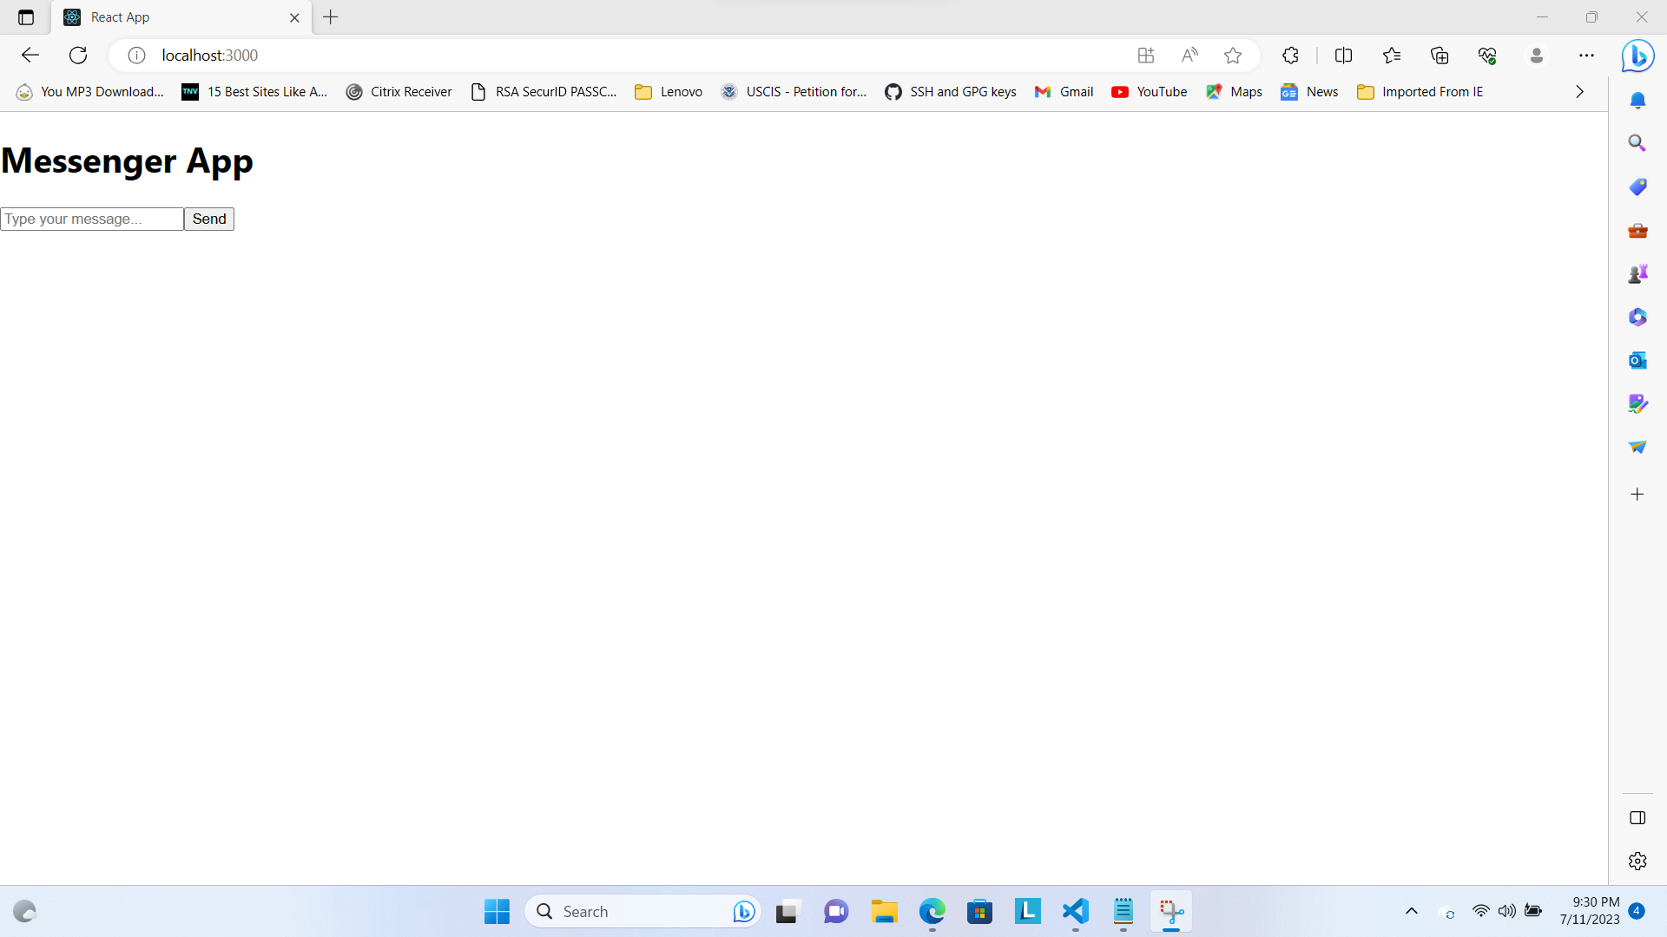
Demo

Slide 6
Directions for Future Development
In the future I would like to incorporate the feature of video calling, where users can send and receive video calling. Also possible feature to add is message timed deletion on certain text, after viewing will be deleted within 30 seconds to a minute, kind of like Snapchat. These are all feature development projects of the future.

Slide 7
Links
https://www.w3schools.com/html/html_css.asp
https://www.w3schools.com/html/html_scripts.asp
https://www.w3schools.com/css/css_dimension.asp
https://www.w3schools.com/js/js_variables.asp
https://www.w3schools.com/js/js_const.asp
https://www.w3schools.com/js/js_arrays.asp
https://www.w3schools.com/sql/
https://www.w3schools.com/nodejs/
https://www.tutorialspoint.com/graphql/index.htm
https://www.tutorialspoint.com/expressjs/index.htm

